Slide 1
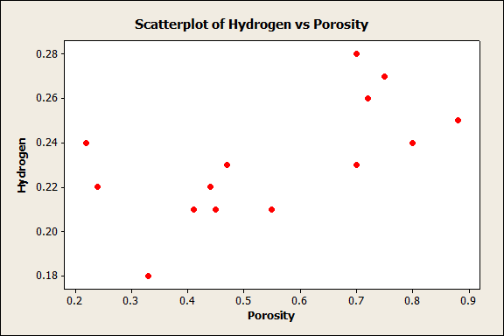
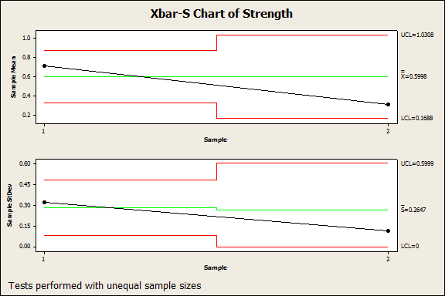
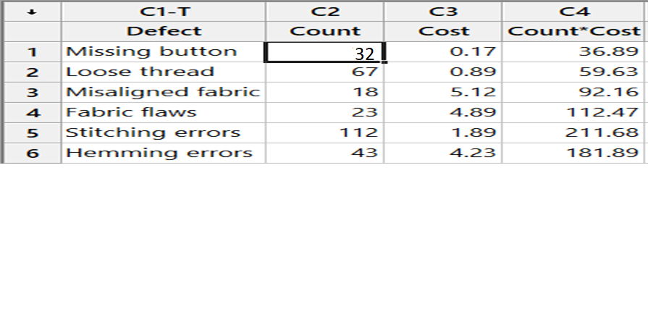
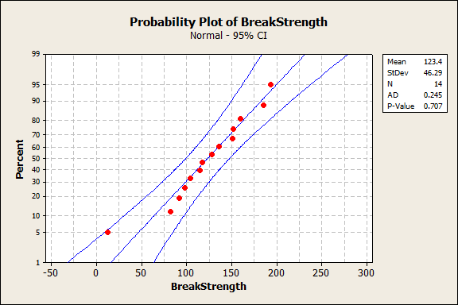
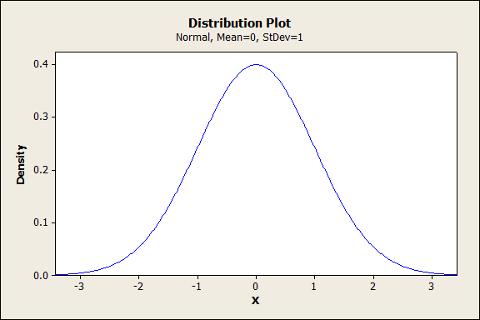
A
MD.Hasib khondaker
ID:201636043
Exploratory Data Analysis Using Minitab
Use Minitab to calculate descriptive statistics .Draw histograms ,boxplots& scatterplots.
Minitab is statistical analysis software.
h
Cause & Effect Diagram
Pareto Chart Of Hydrogen
Scatterplot Of Hydrogen Vs
Porosity
Histogram of Torque
Statistical analysis computer applications have the advantages of being accurate ,reliable & generally faster than computing statistics and drawing graphs by hand.
Bubble Plot Of City MPG Vs Hwy MPG Bubble Size
Xbar-S Chart of strength
Probability plot of Break Strength
Boxplot of Strength
Pie Chart
Distribution Plot

